Slide 1
CS2040C
Welcome

Slide 2
Agenda for the First Lecture
Introduction
About me
About (76++* of) you
Course (online) tools + live demos
VisuAlgo (type https://visualgo.net or… Google search “algo visualization” :O)
Steven’s private “LumiNUS” (doubles as course admin talk, intro of TAs)
I am still learning how LumiNUS works… seems not that different from IVLE??
Kattis (https://nus.kattis.com) online judge (extras at https://open.kattis.com)
(with C++ introduction, using some problems from Week -01/00/01 sets)
Setting Expectations
CP3.19a pre-order (optional, delivery by end of Week 02 :O)
Notes:
Aging UVa online judge is not used from 2018
Aging Mooshak online judge (http://algorithmics.comp.nus.edu.sg/~mooshak) is also not used from Jan 2019

Slide 3
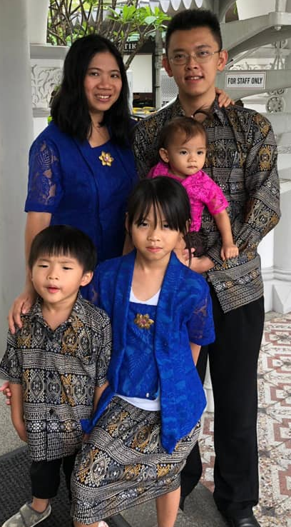
Lecturer: Dr STEVEN Halim
Read this, this, this, this, this, this, or this
Office: COM2-03-37
(usually in every Mon-Fri, 10am-5pm)
Office Phone: 6516 7361
(if nobody answers, I am not in office)
Email: stevenhalim@gmail.com
(search this on Facebook)
Has 1 wife (Grace) and 3 ‘J’ kids (Jane, Joshua, Jemimah)
Wish for CS2040C S1 AY19/20:
To get my usual 0 F (failure) back :O…

Slide 4
77* of you… (quota 200 :O)
 | CEG | InfoSec | Exchange | Poly PP | Minor/2nd Major
Jul 2019 (Steven’s) Estimation | ~20 | ~20 | ~20 | 4 | ~40
Reality (as of 13 Aug 2019) | 7 | 15 | 12 | 4 | 39
PS:
There are a no other known appeal cases as of Fri, 16 August, max 77?
Only “18” first years (freshmen)? The rest are not.

Slide 5
77* of you (continued)
You should have background in at least one programming language
By passing/exempted from CS1010/its variants
This is true for CEG/InfoSec (the main audience)
Mixed background for Exchange/Poly PP students
But historically, ~40% students (your seniors) S-ed CS1010/its variants :O
So I assume most of you have some basic knowledge of C language, and the others with some other programming languages (e.g. Python, Java)
Convert yourself to C++ coder along the way
(No longer) surprising (because I have said so in my welcome emails :O)
I prefer not to teach too much basic C++ in my version of CS2040C
You will mostly self-learn, GIYF, see demos today
We will help A LOT along the way
Real life experience: My kids learning (real) language(s)
Notes:
Those coming from CS1010/E know C, (but CS1010E switches to Python from S1 AY2019/20)
Those coming from CS1010S know Python
Very few already know Java before

Slide 6
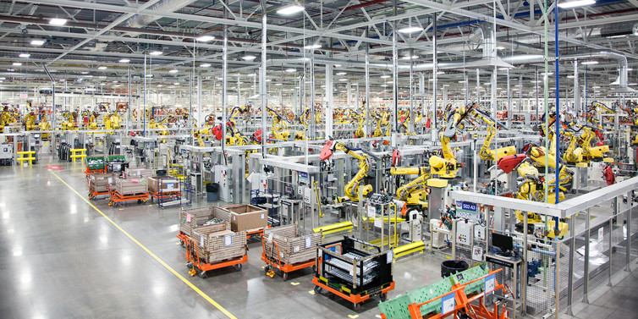
Age of Machines

Slide 7
VisuAlgo (https://visualgo.net)
Built (since 2011) and controlled by myself (but currently on development freeze)
My dream is to have a virtual copy of myself available 24/7
Very patient in explaining basic concepts; Never complains; Always available
Your lecture notes (the e-Lecture mode, demo)
zh/id languages will/have been made ready for 8 CS2040C modules so far ☺
Print-friendly (trial mode): Open console, type “openPrinterFriendly()” :O
Your personal instructor/tutor (the exploration mode, demo)
Your examiner (the 12% Online Quiz, demo)
Register an account (optional)
The current user account system is not that useful yet
Notes:
login for tracking (no need for 2019++ until I fix that sytem)

Slide 8
Flipped Classroom Strategies (for medium to large class)
The style will continue to be enforced, i.e. no basic discussion of ‘trivial stuffs’ if VisuAlgo e-Lecture slides are already clear enough for majority of students
Consequently, those who do not read the prescribed e-Lecture slides before lecture will be really lost during the real lecture…
Steven may? use Facebook polls to gather pre-lecture data on which slides are harder, and will pick top-X hardest slides to be re-explained live, in class
Then for next semester, Steven will polish those slides so that there we lesser such requests
This is a medium-sized class, so I will perhaps use in-class polling tool, e.g. Archipelago (TBC)
We will then able to use remaining lecture time to solve some (easier) Kattis problems that require understanding of the ongoing topic that week

Slide 9
C++ IDE (or lack thereof)
As you should have passed (or exempted from) CS1010 (/variant), I assume you know a bit or two about C/C++ compiler
Our default is C++17 now
My setup is simply a text editor and a compiler
Editor: Sublime Text 2 (“free”), Compiler: g++
For lectures → I use this instant stuff: https://repl.it/languages/cpp
But be careful that everything here is public and only good for quick testing
If you do your PSes online like this, your code can become the source of plagiarism by others who Googled :O…
For PE preparation, I suggest that you learn to use DevC++ though
Notes:
For Sublime setup, if you want, myself, tutorial, or lab TA can help you on this setup thing
But you can stick to your own setup if you don’t prefer this way
CS2040C:
Cygwin64 or MinGW, install g++
CS2040C:
Yet another alternative: CodeBlocks (but this software is notoriously buggy)

Slide 10
For Practical Exam (PE) on Week 06+11 (TBC)
For PE on Week 06, we will do it in lecture (bring your own laptop :O)
You have 5 weeks from now to get up to speed with basic C++
For PE on Week 11 (Details TBC, lots of admin to sort out), you actually just need “any” text editor + a cpp compiler although you are free to use any tool available in our PLs
You have 11 weeks from now to familiarize yourself with C++ related tools that we have in our various PLs, preferably DevC++
You will have to use a PC (laptop) in our PLs for actual PE (controlled environment), PL2+PL4 labs have used new Acer Nitro laptops from last year’s ICPC Asia Singapore 2018

Slide 11
Steven’s CS2040C Private LumiNUS (https://www.comp.nus.edu.sg/~stevenha/cs2040c.html)
Let’s do a tour:
Overview of the module, TAs, syllabus, and course registration information
Latest news will be prominent upon loading that page
Very detailed lesson plan, detailing each week, with integrated ‘Files’ and clear weightage indicator for each weekly milestones
Bookmark important dates on your calendar!
Class roster with mini gamification component
But since there are many of you, only student with at least one achievement will appear in that partial class roster list
PS: Discussion forum are at CS2040C Facebook Group and Discord
Join if you haven’t, you may miss interesting updates otherwise
Create a dummy FB account that contains nothing if you actually don’t like FB
New this semester: We start using Discord too (can be anonymous)

Slide 12
Kattis Online Judge (OJ), NUS version :O (https://nus.kattis.com)
Online judges for (much) more programming exercises
Steven will mention relevant, CS2040C level problems from these OJs
Our PSes will use nus.kattis too
Let’s do a live demo of solving a few simple problems with C++
PS: This is actually a CS1020 ‘first lecture’, see slide notes for the ‘lesson’
Week 01 stuffs: statistics (‘wk1 set’) + one from Week -01 or 00: faktor
Live coding, wish me luck!!
Notes:
This sem:
Kattis statistics, highlighting either a simple array or on-the-fly computation with built in library
Remarks about indentation, preference of as local variable as possible vs global variables :O, variable naming, etc
Last AY
Kattis hello, really just to test the O part of I/O
Kattis judgingmoose, simple if else
Kattis timeloop, simple I and N times O, curly braces styles, indentation styles
Kattis mia, can be used to demonstrate the usage of function to simplify/modularise code, if-else
Kattis treasurehunt, chosen to showcase recursive function (can be written iteratively), also about 2d array and recursive function :O, and first time showing the usage of … global variable :O

Slide 13
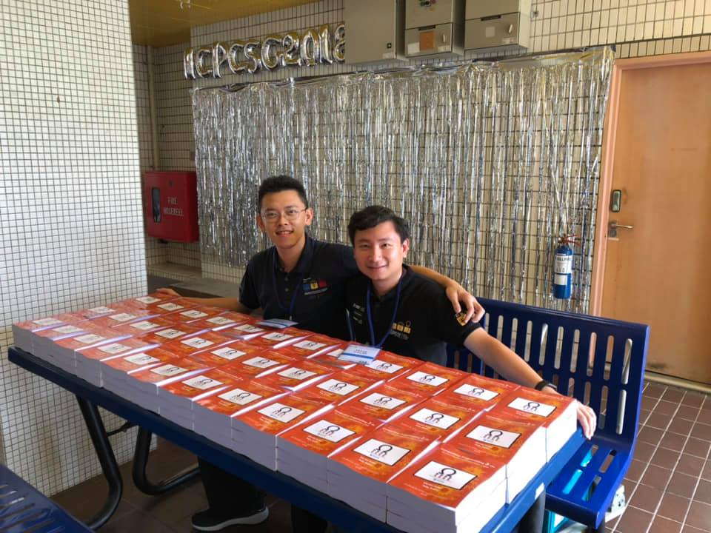
Notes
These admin slides and all relevant C++/Java demo code will be uploaded to (real) LumiNUS “Files” after Lecture 01b
PS: CP3.19a customized for CS2040C+CS4234 S1 AY 19/20
Pre-order at 25 SGD/copy
I am only going to mass print once this weekend, expected ready by Week 02
https://docs.google.com/forms/d/e/1FAIpQLSf3wF_Nff5ORsfURWh7aLOvDIwsFnAz59nELoWCmzXUl858hA/viewform
You can borrow older editions from seniors/friends
This version is A5, without the fancy cover

Slide 14
Demos, continued The actual Java/C++ lesson topics are written as comments in Java/C++ code; All source code will be zipped together and sent to you later
Now we discuss a bit of Object Oriented Programming in C++
For exposure only, will be revisited in future lectures/tutorials/labs
quickbrownfox (chosen to illustrate C++ ‘class’, a bit overkill)
Similar problem from last AYs: bookingaroom, princesspeach
Notes:
For CS2040C only -> Remarks about #include <bits/stdc++.h>, https://www.quora.com/Is-it-good-practice-to-use-include-bits-stdc++-h-in-programming-contests-instead-of-listing-a-lot-of-includes
Kattis princesspeach / Kattis bookingaroom, a practice using a C++/Java class, we actually can solve this problem without even using a class, but I have to teach you C++/Java class :O, so…

Slide 15
Setting Expectations
You canNOT S/U this level 2 module (it has pre-requisites :O)
Aim for the best possible grade that you can get
CS1231 is NOT set as pre-req; relevant material will be pre-discussed
With 77* students (S2), NUS standard Bell Curve system is used
Read this public writeup of the 2012 version of NUS Bell Curve system written by the previous NUS provost, now current NUS president
Work hard to self learn as many programming language components
As I said, we will help along the way, throughout this module
CS2040/C will NOT use very deep Java/C++ concepts
For CS students, you will learn deeper Java stuffs in CS2030
CS2040/C assignments will be short (< 50 SLOC), unlike CS2030/CS2103++

Slide 16

Help with Flipped Classroom
This learning technique is likely very new for many of you
It takes lots of self-discipline to make it work
Pre-read the e-Lecture slides @ VisuAlgo before coming to live lecture
You will be very lost otherwise…, I will be very strict on this :O
Ok, finally I do webcast… (I didn’t do that in the past 2 AYs) :O
https://luminus.nus.edu.sg/modules/9a0814fc-bd0a-42de-97ed-ffd8ccfbe8f2/web-lectures?fbclid=IwAR0k-v7LqDGqRlkgEL-DQNUFjypZqSQCXry9RnRMJ1nie5hYGlUaIKGUzm4
Ask lecturer or TAs for help, especially during early days
Our consultation hours are shown in Steven’s private LumiNUS

Slide 17
Prelude to the First Real Flipped Classroom
Skim through CS1020/E Analysis of Algorithms lecture note that will be zipped and sent to you after this together with some demo code so far (in C++ and perhaps also in Java/Python :O)
By next Wednesday, 21 Aug 2019, you must have read https://visualgo.net/en/sorting?slide=1 until slide 8-3 at least
Super duper lost otherwise…
See you again soon…

